Slide 1
Introduction to spring fw and openapi echosystem

Slide 2






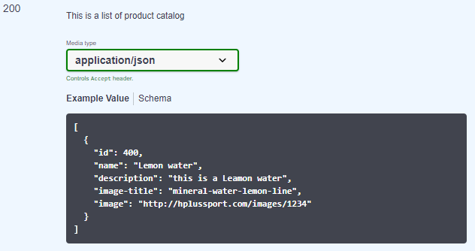
The Global Architecture
Spring Implementation for Java EE Specification
OpenApi (3.0.0) Specification
Data
Engine
End-Point
DB
MVC
Spring Modules :
- JPA (Hibernate) : Repositories and Entities and
Data Mapping
- Services : The Business Requirements.
- Mvc : Controllers and Models (RestControllers)
Data from Mainframe
The End Response in JSON format
Notes:
La solution pourra être résumée.
En trois parties :
La source de données (data base)
Un client final qui veut avoir ces informations dans un format Json
Pour atteindre ce but on devra développer notre backend en utilisant Spring Framework
Ce process développement devra absolument suivre le pattern de Java EE spécifications et ces implémentations, ainsi que Open Api Specification pour la partie frontend du software. Car le but ultime de notre travail est que cette les fichiers et les requêtes que nous recevons dans nos end-point doivent communiquer avec d’autres API ou d’autres plateformes. Pour cela il faut être très rigoureux sur le respect du model et des spécifications pour avoir un produit consistant que nous pourrons tester et maintenir dans le futur.
La question qui se pose par les développeurs est : comment peut-on atteindre ce but ? la réponse est une bonne connaissance de l’architecture et les bons outils et les bonnes pratique que nous allons exposer dans cette présentation pourrons vous aider a le faire .

Slide 3
The Java Enterprise Web Application Architecture
Others Web Fw
Application Server
(Apache+TomCat)
Spring Environment
Web Client
Présentation
MVC
Servlet Dispatcher
@Controller
@RestController
Views and models
HTTP JSON,…,
MVC
REST
Thymeleaf
JAVA C++ Python
Service Business Layer
Servicre
@Service
@Bean
@Configuration
Data Access Layer
Servicre
@Repository
@Entity
@ManyToOne
@Query …..
JDBC
JPA 2.0
Spring DATA -Rest
IOC CONTAINER (SPRING FW/ EJBs)
DB
Notes:
Principalement les application java web Enterprise sont segmenter en trois distincts couches.
Nous allons voire brièvement un aperçu sur ces couches et quels sont les composant Spring de chaque couche.
La première couche de développement est la couche présentation. Cette couche englobe tous le front end de l’applicatif. Dans cette couche nous serons exposée a des outils et des technologies comme Thymeleaf , JSF , Jax, JSON et MVC (principalement le MVC est un model pour développer la couche présentation) .
Vous pouvez voire a droite de l’écran les différente composants Spring utiliser dans cette couche (Controller, Servlet, RestController qui sont principalement les composant de Spring MVC).
La couche Service est le coure de notre applicatif. C’est dans cette couche que nous développerons notre business logique. Cette couche relie la partie présentation et la couche d’accès aux données.
Du côté de Spring c’est dans cette partie-là où nous développons les interface (Java in2terfaces) et leurs implémentations généralement les beans (Object) de cette couche sont annotés par @Service.
La couche Accès aux données : cette couche constitue la frontière entre le Object Model qui est notre application JAVA et le « Relation Model » qui est notre base de donnes.
Dans cette couche nous utilisons les ORM come Hibernate, puisque nous utilisons Spring alors Spring-Data-JPA est le module à découvrir, pour d’une part créer les éléments de cette couche
(Entities and Relationship) et d’autre part faire le chemin inverse d’une information qui remonte d’un champ dans une table de base données et en passant par le Repository au Service au Contrôleur jusqu’à sa mise à disposition à l’utilisateur final.

Slide 4

Questions
What is the Spring Implementation …. Specification ?
JPA, Services , Beans , AOC , Dependency Injection …????
Are we using MVC ?
What is OpenAPI Specification and Swagger ?
How to learn about these specifications
Notes:
Nous avons parler de beaucoup de concept théorique qui sont important pour se retrouver dans le labyrinthe du software Engineering.
Je suppose que vous vous poser la question si ces choses l’existent dans notre actuel projet ?
Bien sûr que oui. Mais en premier lieu nous allons créer un projet Spring ou nous allons se familiariser à l’écosystème à travers un exemple réel

Slide 5
- The Spring Framework Environment
1- Spring Boot Project :
Creating a Spring Boot Project
The Project Structure
Maven Goals
2- Spring Data-JPA
a) Definition
b) what the difference between Hibernate and JPA and Spring-Data
c) A Small lab to implemented Tables Relation in the Object Side
Notes:
Nous allons commencer à créer notre projet mais avant cela nous examinons brièvement une des Spécifications de Java EE que nous utiliserons souvent dans nos projets (JPA)
Sa vous permet de savoir ou trouver la bonne information en cas de besoin .

Slide 6
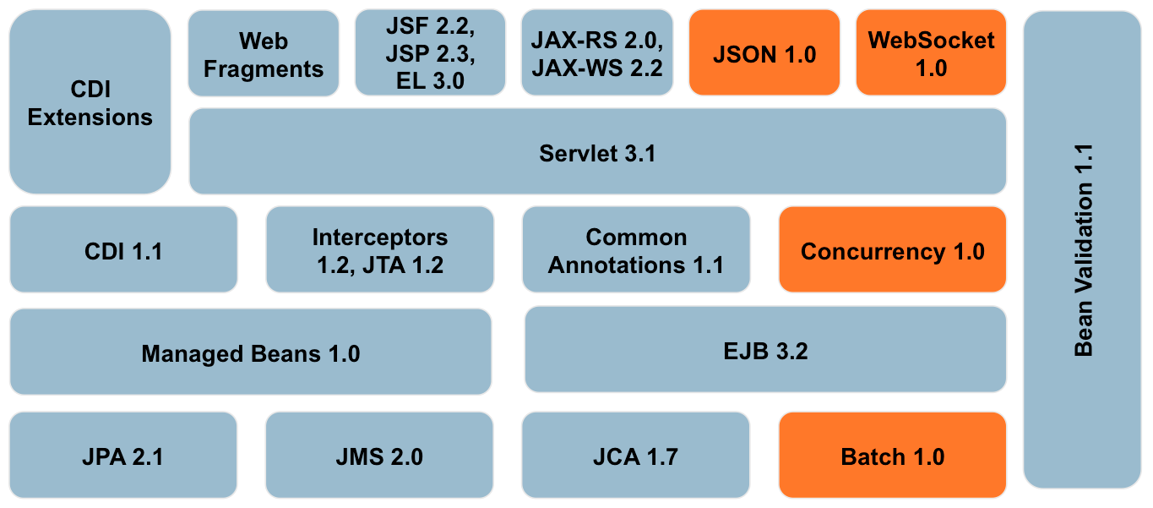
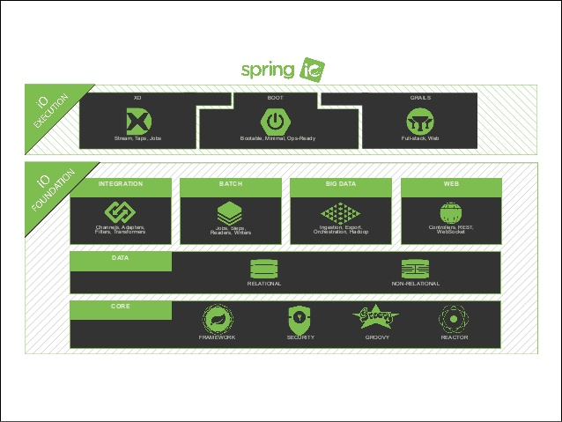
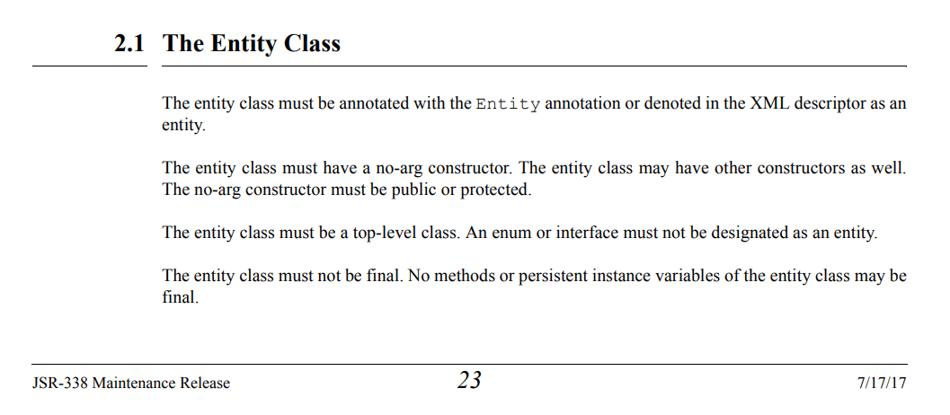
Introduction :
Java EE 7 Specifications
Spring Ecosystem and Implementation
https://download.oracle.com/otn-pub/jcp/persistence-2_2-mrel-spec/JavaPersistence.pdf?AuthParam=1583261958_4df0126169e67f77c6b296d52bb88073

Slide 7
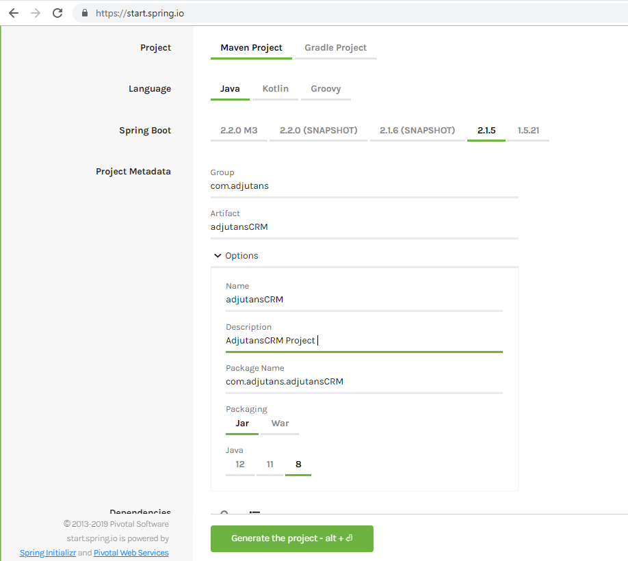

create a Spring-Boot Project
Spring-Boot project is a Maven project . it can be created by the EDI (Eclipse, STS , Intellij,..) or by the spring initializer tool (web) at : https://start.spring.io
Spring Boot Core Version
Maven Project parameters , properties (JDK version, packaging mode, package name , groupId $ artifactId)
And dependencies selection
Generate a ZIP maven project ready for import in the EDI
Notes:
Les different module d’un projet spring

Slide 8
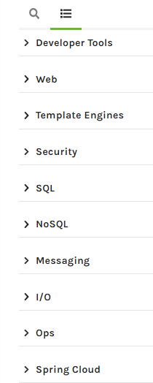
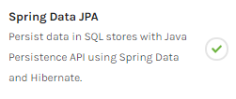
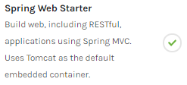
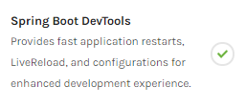
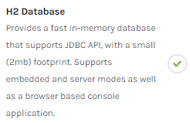
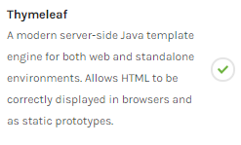

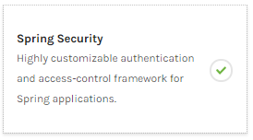

create a Spring-Boot Project
Selecting Dependencies

Slide 9
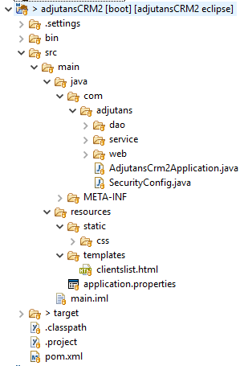
The structure of Spring Boot Project - Folder Structure
The /src and pom.xml are the only tow important pieces of the project
The .settings , .project, .classpath ar specifique to Eclipse EDI they can be regenerated by the EDI based on the POM.XML configuration
The Package structure : com.adjutans
Back-end / front-end .java files (repositories , entities ,controllers ..)
2- Spring Data-JPA
The Main Class of the project
The Resources of the Project :
The Static folder contain all static features as Images, Bootstrap/CSS , JQuery .
The Template Folder Contain the Views (HTML files) and the layout of the Project.
The application.properties contain the configuration parameters of the project as the datasources, profiles, …..
Maven Target Folder contain the compiled Classes and the Jar of the application generated by the maven native package goal or by spring-boot:repackage goal
The Core configuration file - The ONLY Source Of Truth !!
Notes:
Structure du projet

Slide 10
2- Spring Data-JPA
To build the Data Access layer of our example we will use Spring-Data- JPA – the Spring implementation of JPA2.2
Javax.persistence.Api library and Hibernate .
Throw this example we will build 4 Entities in the project domain (model)
Person , Address, Car, Project
We will learn how to implement relations between this tables using JPA.
OneToOne, OneToMany, ManyToMany ManyToOne.
We also expose to cascade information between entities ( Bidirectional / unidirectional relationship)
This example is not limited to spring data , but studding this module lead us to get other knowledge as :
How to configure Spring project
How to build properly a project using maven
How to build other layers (controllers, Services..)

Slide 11
2- Spring Data-JPA
Mapping the Relationship between tables in the Object side:
a)One To One Relation (1:1)
to implement a one to one relationship we use the JPA annotation @OneToOne.
The annotated Class with @OneToOne ===> the corresponding Table will receive the foreignKey
(Class Person contain @OneToOne ===> Table Person receive de key from Address0
- The name of the join column is generated by default (Tablename_id) to change it we use the annotation
@JoinColumn(name= Adr_FK)
- To implement the bi-directionality of the relation we add a property person in address table annotated by
@OneToOne(mappedBy="the_property_name_in_the_Other_Table")
the mappedBy side is the master of the relation

Slide 12
2- Spring Data-JPA
Mapping the Relationship between tables in the Object side:
b) Many To One Relation (n:1)
to implement this relation we will use a Car example ;
Many Cars are owned by One Person,
- we have an entity Car with the external property owner of type Person.
- //and in the Person class, we have a List of Cars
the logic in the DB the key of the one side migrate to the "many" side.
c) One To Many Relation (1:n)
Keep in mind that in the databases the key of the one side migrates to the "many" side.
To implement One person owned many cars,
In the person class we should add a List<Car> of cars annotated with @OneToMany.
the problem here is :
the person key will migrate to the car (according to the
logic of DB were the one side key migrate to the "many" side)
But, the annotation IS NOT in the car class so we will crack the rule of
(The annotated Class ==> the corresponding Table will be modified by adding the foreignKey)
so the solution is that the DBMS will generate an intermediate table (a join Table)

Slide 13
2- Spring Data-JPA
d) One To Many / Many To One Bidirectional Relation
after implementing the Many To One and the One To Many Uni-directional
know we can have the case when I'm in the car, I can get the owner (person) and when I m in the person I can get
the list of the owned Cars.
- the first idea that comes is the use of mappedBy property. the logic here is
"The One is More Powerful than the Many"
so the key of the one side will migrate as a join column and the mappedby will be in the OneToMany
e) Many To Many Relation
entities can also have a many-to-many relationship. Let’s say you have a list of projects, and a list of person project
may have one or more persons working on, and each person may work on multiple projects.
In this case, you have many persons related to many projects. to represent the relationship between these
two lists of entities we use @ManyToMany annotation.
in the unidirectional case, the ORM create an intermediate table

Slide 14
The Model –View-Controller (MVC) Design Pattern
Widely used in a variety of web application frameworks;
• Created by Xerox engineers in the 1970s;
• All three elements must be present in all web apps, what sets MVC apart is a clean separation
of the components.
Apache Tomcat Server
Model
(POJO or Data Structure)
USER Browser (HTTP Req /action1)
Controller Class
Action1()
Action2()
DB
Service Layer
D A Layer
(Repositories and Entities)
View (Rendered To the user)
Notes:
Apres avoir examiner le JPA. afin de render Notre projet encore plus interessant nous allons explique brievement le model Spring MVC pour etre en mesure de creer un controleur qui expose nos donnees sous format JSON

Slide 15
Spring MVC Pattern diagram.
Handler Mapping
Dispatcher Servlet (Front Controller)
Controller
Service
USER Browser (HTTP Req)
Model (POJO)
DB
Model (POJO)
View (html Rendered To the user or JSON or XML in Case of Rest Request)
Notes:
Dans spring MVC le Dispatcher Servlet est le cœur du model elle Elle reçoi les requêtes de l’utilisateur EX : http://localhost:8080/person
Elle recherche dans le registre si une des méthodes définies dans le contrôleur est annoter par @GetMapping("/person") elle redirige la requête vers cette méthode qui va
De sont toure retourner un model a la vue qui va être retournée a l utilisateur .
Nos allons créer un simple contrôleur qui vas interagir avec la partie service pour retourner un JSON file au client

Slide 16
Part II – Rest API ecosystem

Slide 17
Why they are exposing their data as an API ?
Wider reach (e.g., of an organization’s brand),
External sources of innovation (i.e., facilitating the idea of
open innovation),
New or extended sources of revenues.
Is there any regulations or norms to standardise API ?
Yes, OpenAPI Specification (OAS) defines a standard to create, secure and expose end point data and functionality of an organization to public or private users.
https://github.com/OAI/OpenAPI-Specification/blob/master/versions/3.0.0.md.
Swagger is a set of tools witch give us the possibility to build API under OpenAPI requirements.

Slide 18
How to install swagger UI /Editor
# Install npm packages (if needed) npm install
Swagger software can be used as local web (free) application or throw the swagger-Hub portal where we can get access to a bench off collaborative development and design tools.
1- Download Swagger UI/Editor project :
https://github.com/swagger-api/
2- to use swagger we need NodeJs to be installed in the local machine d
Install npm packages (if needed)
> npm install
Install http-server
> npm install –g http-server
in the Swagger-editor path run the stactic local server
> http-server swagger-editor -a 127.0.0.1 -p 8080
in an other terminal start swagger UI instance

Slide 19
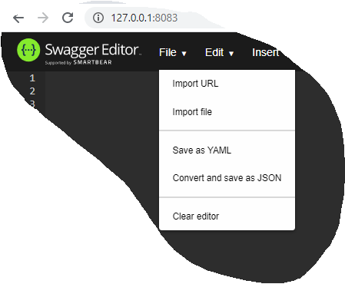
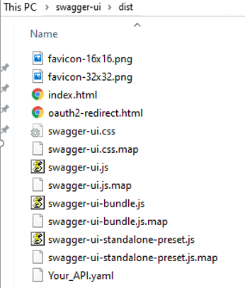
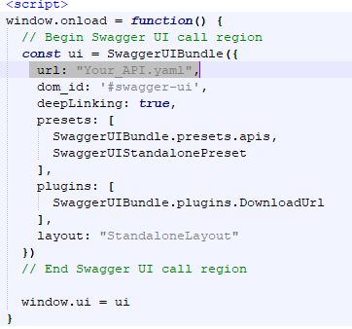
How to install swagger
How to install swagger UI
After creating the API, export it from swagger editor and put it (the YAML file) under Dist folder of swagger UI
Inside this folder open index.html and change the url of the method window.onload () to your Yaml file
- Copy the Dist Folder (rename it To myApi) - > http-server myApi -a 127.0.0.1 -p 8082

Slide 20
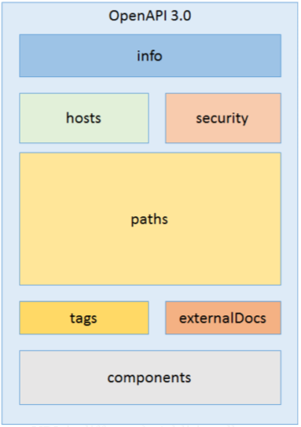
Creating the API Definition
Before writing the API definition it is important to know the different part of an API (OpenAPI 3.0.0)
Info Object : It contains general API information (Name, description, contacts and licence
Hosts/ Servers : identify the URL and the description of the servers hosting the API
Security : it how the API is secured .
Paths : Within the paths object, we specify the end points that describe how to access resources on the API. It describe the incoming and outgoing data requirements in detail.
Tags: define labels that can be used to group API operations.
ExternalDocs: links to external resources about the API
Components: allows you to define reusable components as common schema objects, parameters, request bodies, and responses.

Slide 21
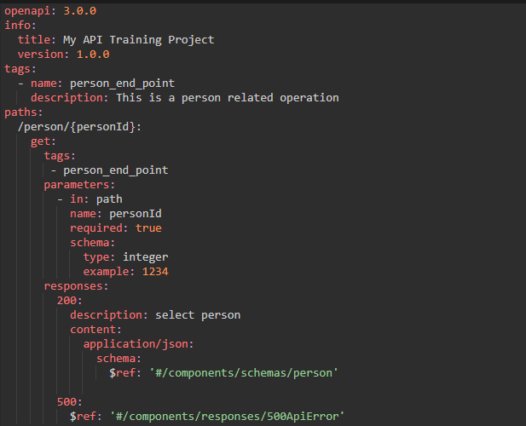
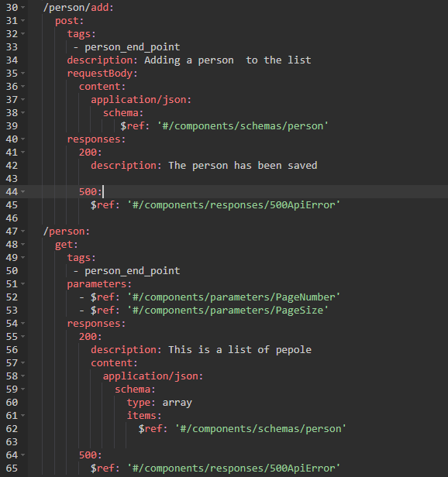
Creating the API Definition
In the swagger Editor we will create a simple API to expose the data of the person that we create in the previous
project

